Slide 1

AI's Impact on Modern Web Development
This presentation explores how AI tools like ChatGPT and Gemini are revolutionizing modern web development. We'll delve into their impact on streamlining workflows, boosting efficiency, and reshaping design and coding processes, while also addressing the benefits and challenges of AI integration.

Slide 2
AI's Role in Web Development
Streamlined Workflows
Enhanced Creativity
AI tools like ChatGPT automate repetitive coding tasks, freeing developers to focus on complex problem-solving and creative innovation. This optimization extends to code generation, UI design, and debugging, resulting in increased efficiency.
AI empowers developers by suggesting innovative solutions and exploring novel design possibilities, pushing creative boundaries beyond conventional approaches. This assistance provides valuable insights and alternative perspectives, leading to more inventive and effective outcomes.

Slide 3

Prompt Engineering and AI Interaction
Crafting Effective Prompts
Context is Key
Leveraging Role-Playing
Precise prompts are crucial for generating accurate and relevant AI outputs. A well-defined prompt, such as "Generate an HTML structure for a responsive portfolio website," yields highly targeted results.
Providing detailed context ensures the AI aligns its suggestions with your vision. Including project objectives, for example, "Design a travel blog showcasing high-resolution images," guarantees outputs that meet your goals.
Defining the AI's role, such as "As a front-end developer, recommend a responsive grid system," harnesses its adaptive learning for specialized solutions.

Slide 4




Navigating Challenges and Solutions
Ambiguous Prompts
Unclear prompts yield inaccurate results. Use precise, specific questions for better AI responses.
Cross-Browser Compatibility
Ensure consistent performance across browsers using CSS resets, vendor prefixes, and thorough testing.
Debugging Issues
AI-powered debugging tools and automated tests streamline complex error resolution.

Slide 5
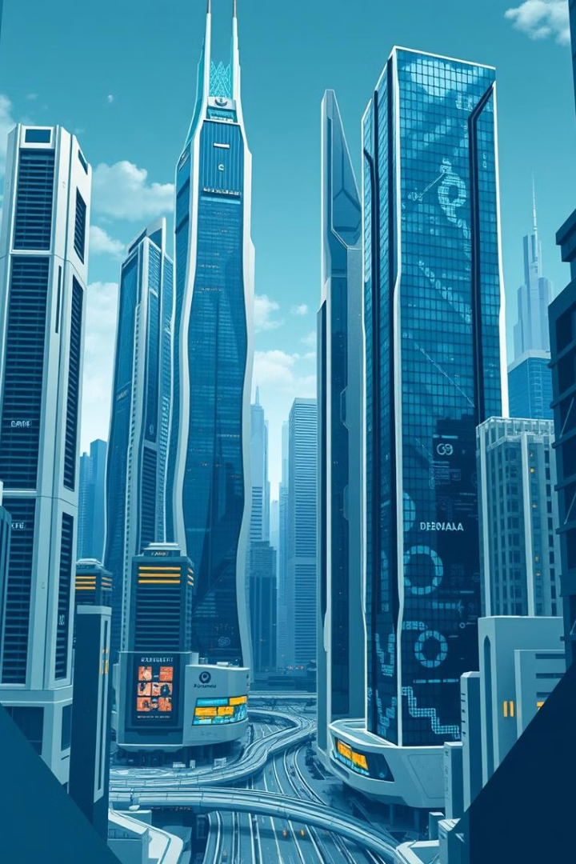
The Future of AI in Web Development
1
AI-Powered Content Creation
AI will automate content generation, creating personalized user experiences and enabling real-time interaction analysis.
2
Revolutionizing Web Design
AI tools will boost design flexibility, efficiency, and precision, streamlining workflows and empowering developers to build dynamic websites.
3
Prioritizing Ethical AI
As AI evolves, responsible development demands attention to data privacy, algorithmic fairness, and broad societal impact.

Slide 6



Key Takeaways and Next Steps
Streamlined Web Development
1
AI boosts efficiency and unlocks creative potential in web development workflows.
Addressing AI Challenges
2
Challenges like prompt clarity and design consistency are overcome through precise instructions and continuous learning.
Responsible AI in Web Dev
3
Prioritize data privacy, fairness, and ethical considerations for positive societal impact.

